Slide 1

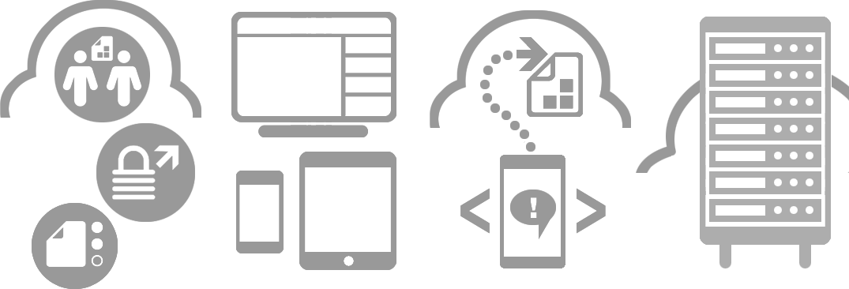








Storage Administrator scenario with Point.io web console
Julien Gaye
Sales Engineer
+44 7708 147 445
jgaye@point.io

Slide 2
Storage Administrator scenario
The Storage Administrator is connecting storage resources to the platform, and allowing Project Manager to use them.
He is managing the Gateways, Storage Sites, the access to Storage Sites by other users and monitors all the activities in his Storage Sites.
The next slide shows the required components for a user interface
Green components are available in the current web console
Yellow components exist but are not displayed in the current console
Red components don’t exist yet

Slide 3
Manage Storage
Storage Sites list
New Storage Site
Monitor Storage Site’s Activity
New User Access
Remove User’s Access
User Accesses list
Manage Accesses
Remove Storage Site
Activities list
Storage Types list
Storage Information fields
Manage Gateway
Gateways list
Link Gateway
Unlink Gateway
Gateway Information fields

Slide 4
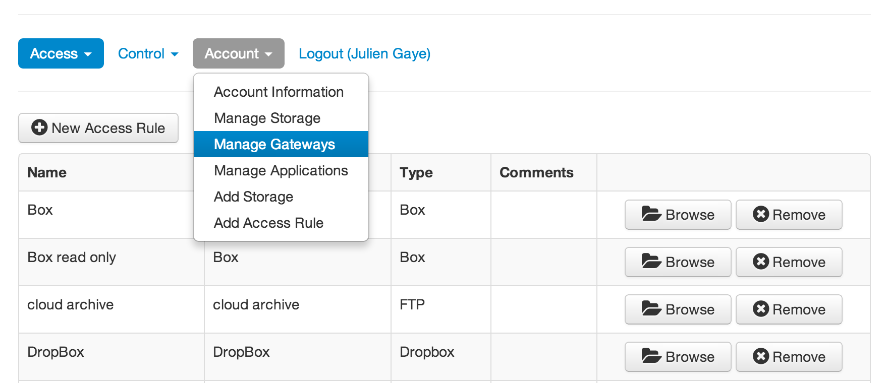
The Storage Administrator accesses the Gateway Management page via Account -> Manage Gateways
Notes:
The Storage Admin

Slide 5
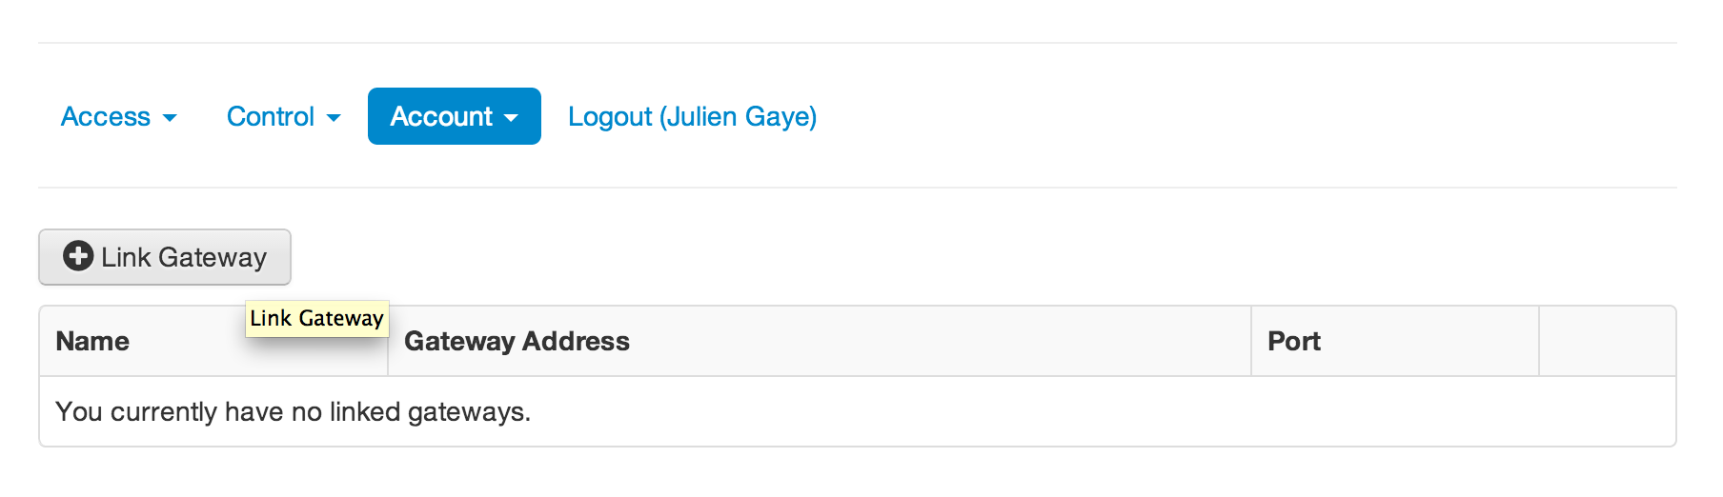
The Storage Administrator links a new Gateway to the platform using the Link Gateway button
Notes:
The Storage Admin

Slide 6
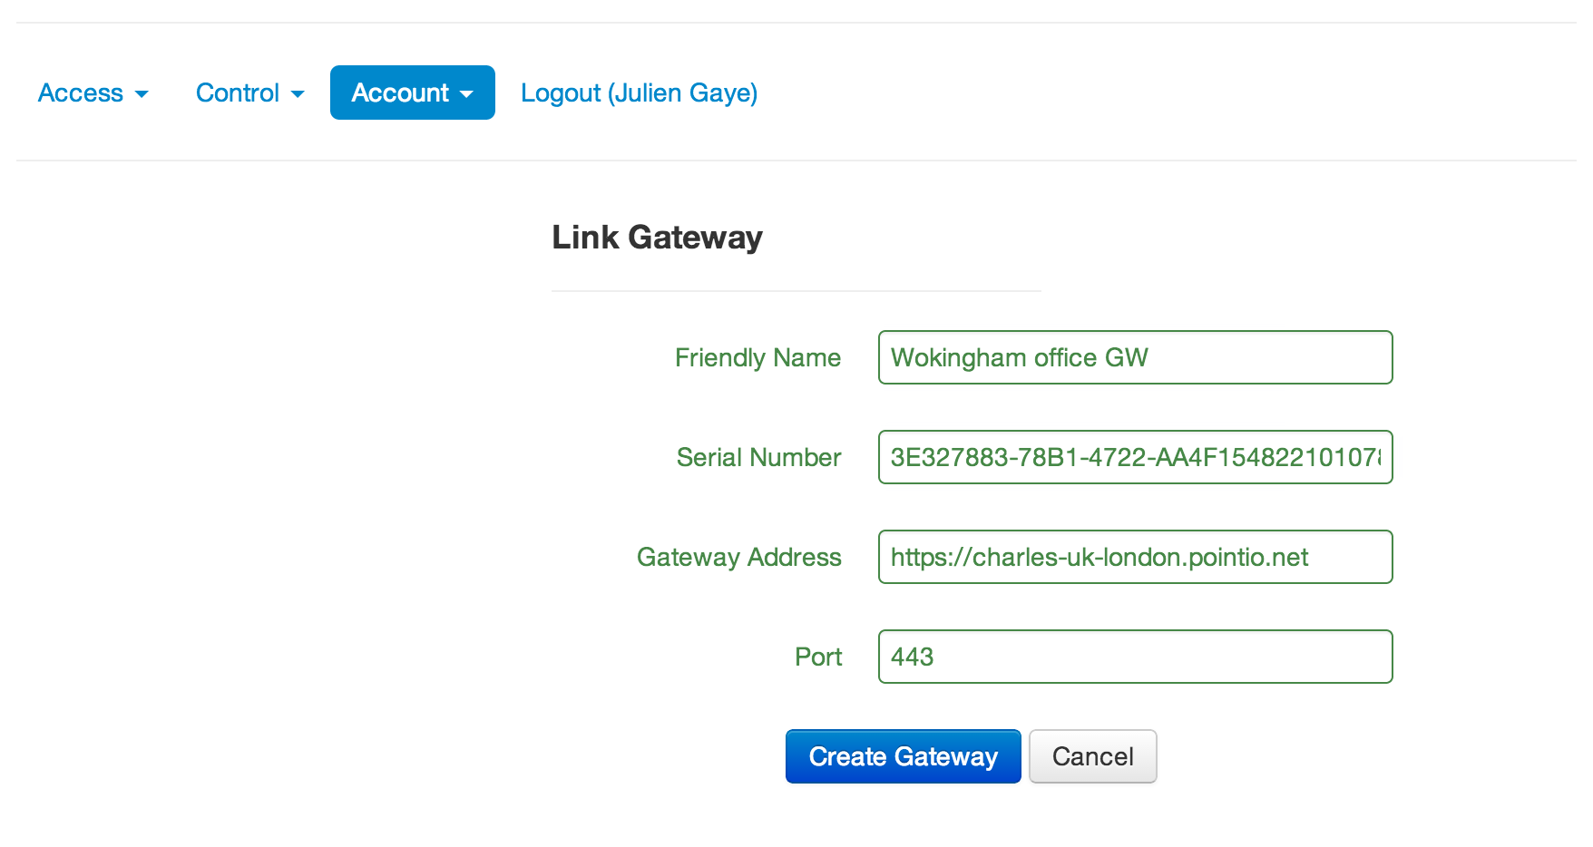
The Storage Administrator fills the Gateway fields accordingly to the Gateway installation in the enterprise’s environment
Notes:
The Storage Admin

Slide 7
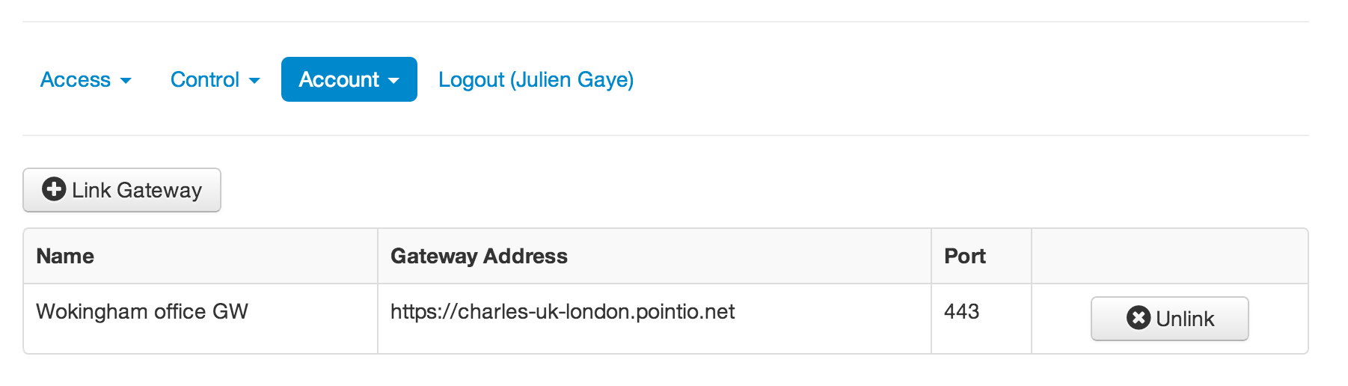
The Gateway is linked to the platform and is added to the Storage Administrator’s list. The Storage Administrator can unlink a Gateway from the Gateways list.
Notes:
The Storage Admin

Slide 8
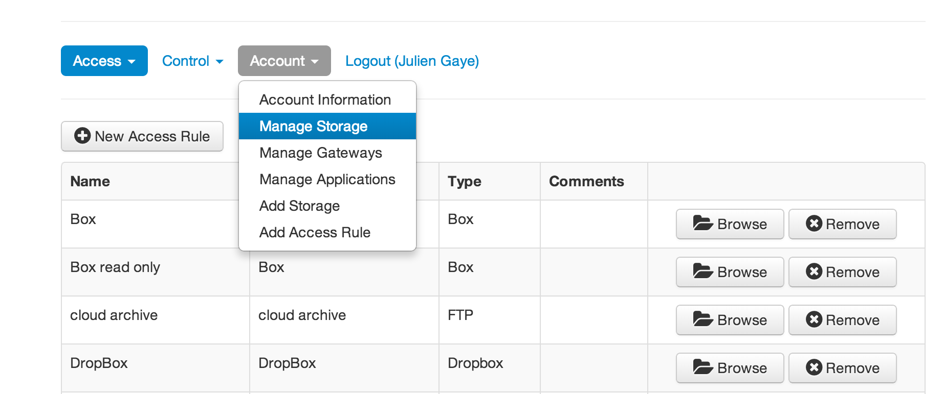
The Storage Administrator accesses the Storage Site management page via Account -> Manage Storage
Notes:
The Storage Admin

Slide 9
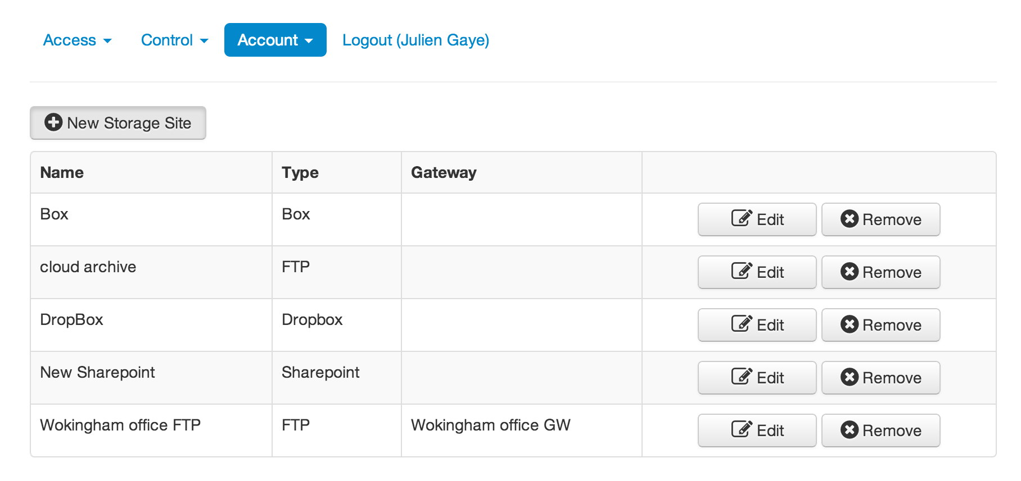
The Storage Administrator connect a new Storage Site to the platform using the New Storage Site button
Notes:
The Storage Admin

Slide 10
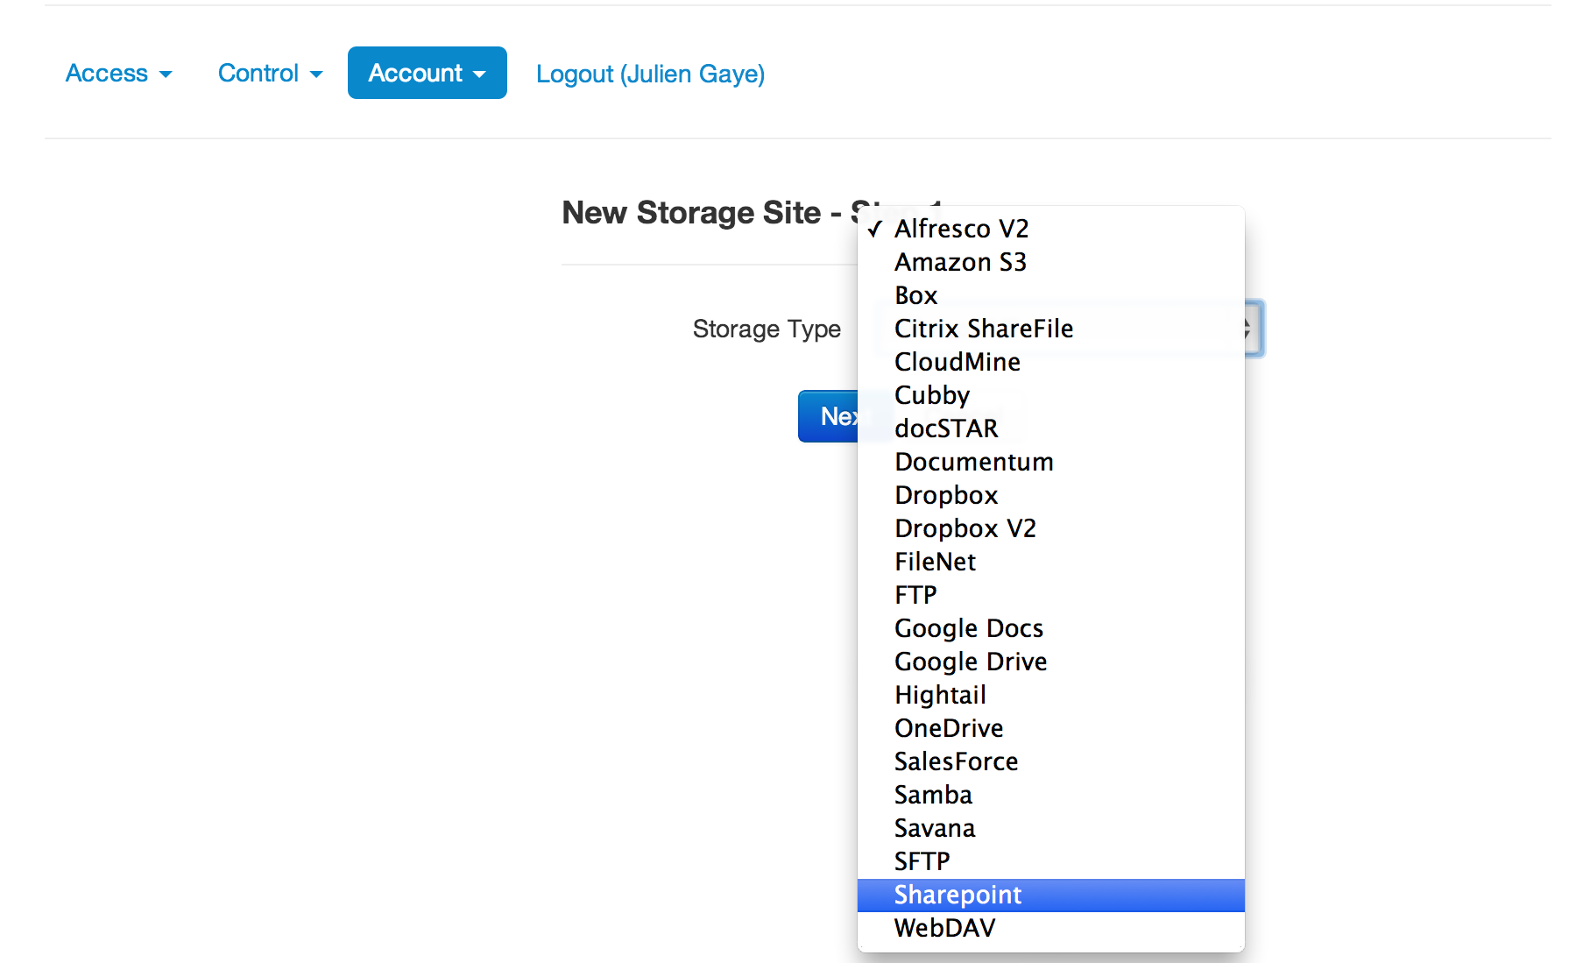
The Storage Administrator selects the storage type among the available storage types.
Notes:
The Storage Admin

Slide 11
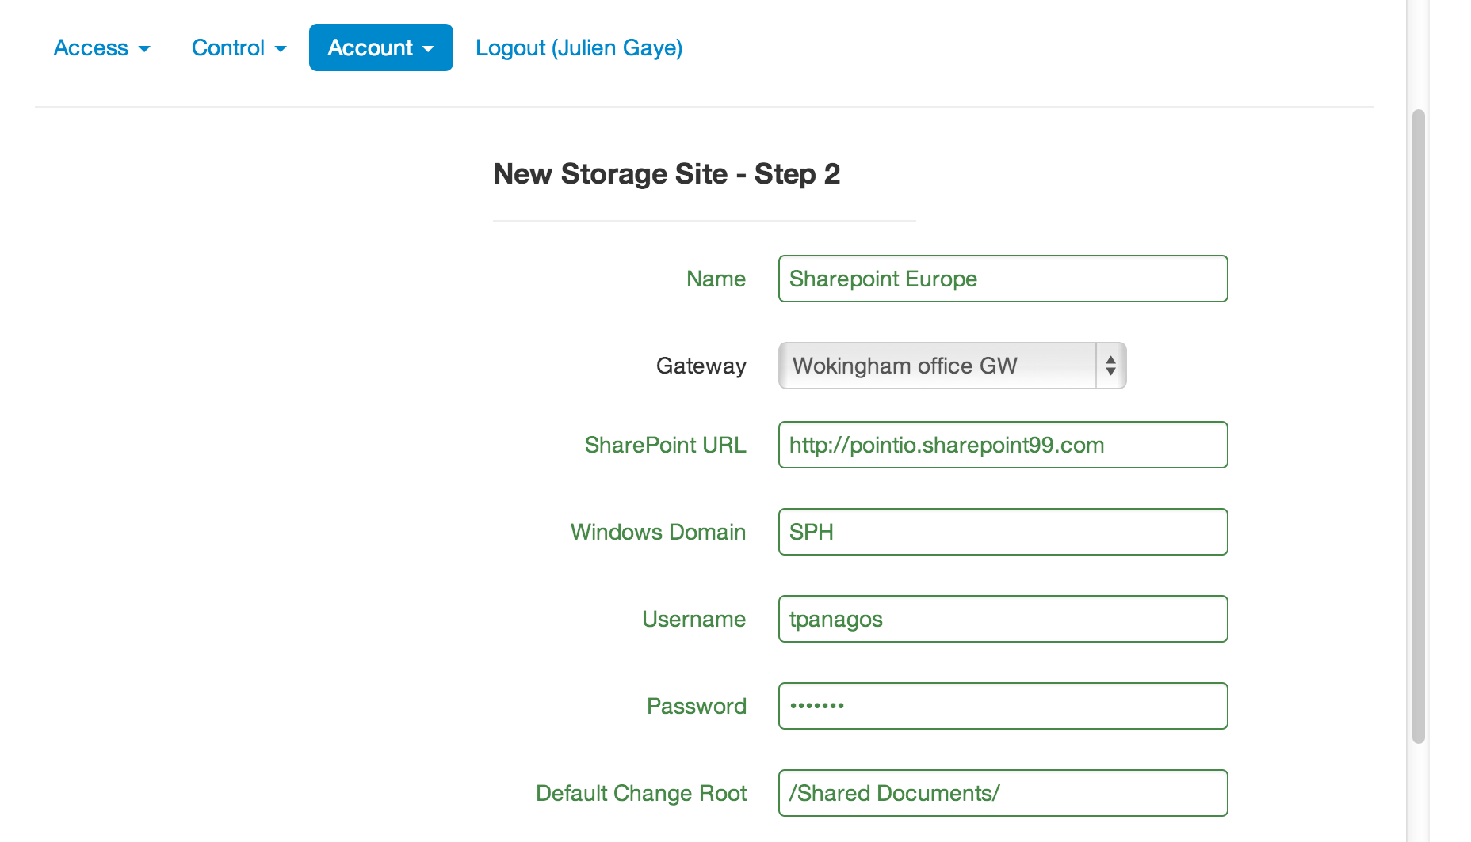
The Storage Administrator fills the storage site information fields and validate the connection. The Gateway used has to be the Point.io appliance installed in this storage resource’s environment.
Notes:
The Storage Admin

Slide 12
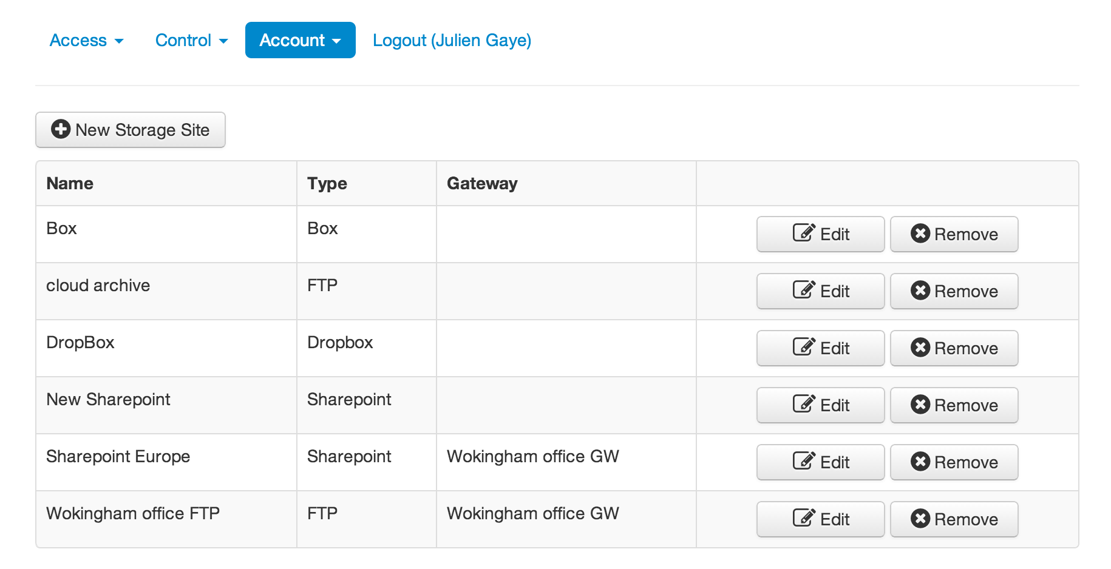
The new Storage Site has been added to the Storage Site list. Storage sites can be edited and removed from the list by the Storage Administrator.
Notes:
The Storage Admin

Slide 13
Use case functionalities not implemented in the current web console
The next step would be to grant access to a storage site to a Project Manager, but this is not available with the current console.
The Storage Site monitoring isn’t accessible via the console yet.

